Slide 1



Topology Optimization via Frequency Tuning of Neural Design Representations
Nikan Doosti¹, Julian Panetta², Vahid Babaei¹
¹Max Planck Institute for Informatics - Saarbrücken, Germany ²University of California, Davis - Davis, United States

Slide 2
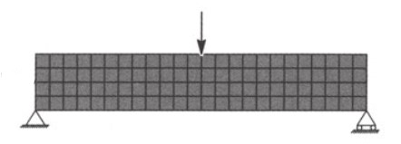
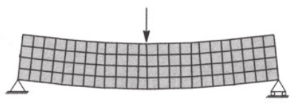
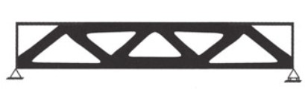
Background
Minimum compliance
Bendsoe, M. P., & Sigmund, O. (2013). Topology optimization: theory, methods, and applications. Springer Science & Business Media.
F
F
Ground structure (mesh), force and total available volume
Optimal binary design
Displacement due to force
F: Load, Pixels: Elements (darker is denser)
Notes:
We showcase our design representation by solving the minimum compliance TO problem. This problem seeks to find the stiffest possible structure to support the applied forces without exceeding a weight budget.

Slide 3
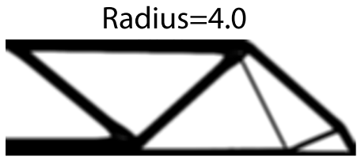
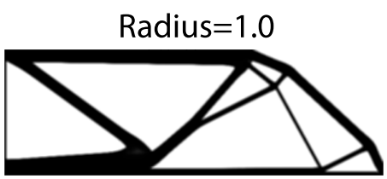
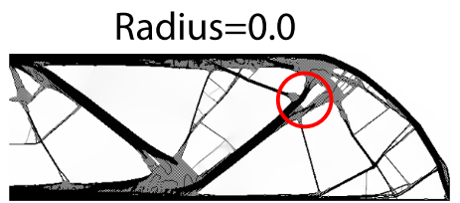
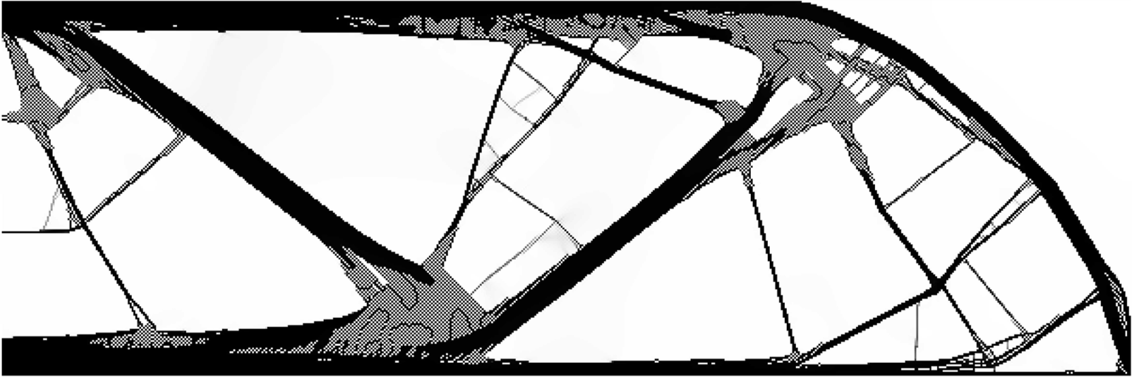
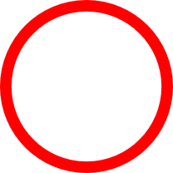
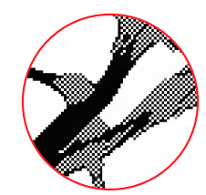
Background
Radius=1
Traditional TO and filtering
Size of neighborhood in filtering affects the intricacy of solutions
“checkerboard effect”
Notes:
1. Conventional methods for minimizing compliance suffer from the well-known checkerboard problem. They generate non-physical designs with high-frequency checkerboard patterns.
2. To prevent this from happening, a mesh-based smoothing filter is necessary.
3. On the other hand, increasing the radius of smoothing filter can over-smooth the designs and increases compliance.

Slide 4
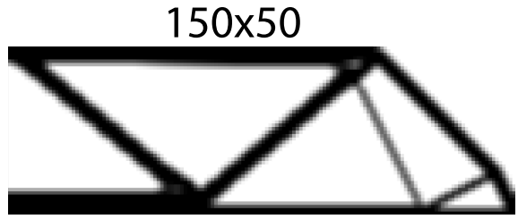
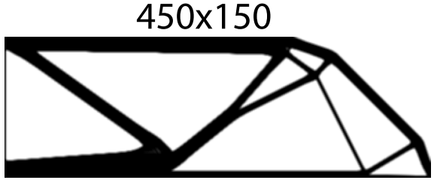
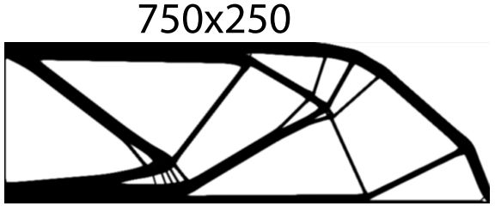
Background
Traditional TO and mesh size
To obtain intricate designs with lower compliance, higher mesh size is needed
Notes:
To obtain more intricate designs that have lower compliance (our objective function), we need to use larger meshes, if we use a fixed filtering.
The main issue here is that increasing mesh size heavily increases the computational cost of solving the problem.

Slide 5
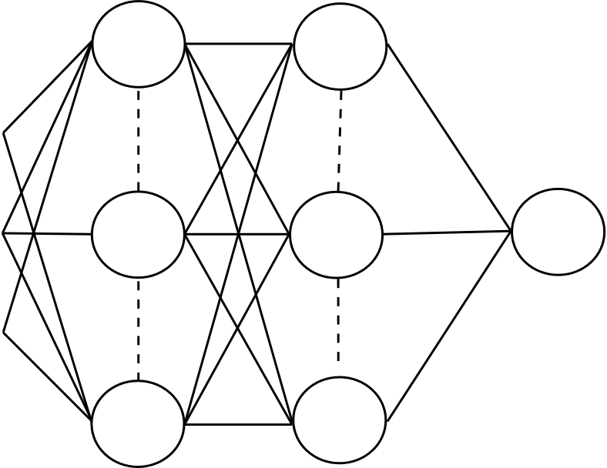
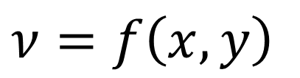
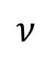
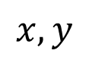
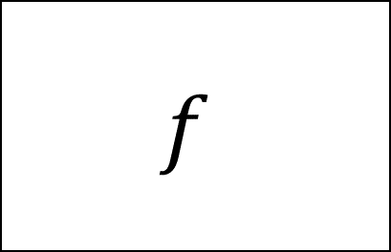
Alternative Representations
Explicit representation and neural networks
$ν=f\left(x, y\right)$
Input coordinate
Query function
Target variable
$$f$$
$$x,y$$
$$ν$$
Fast, efficient and expressive
Notes:
There are different methods of approaching to this topic, which explicit representation is closest to our line of work.
In this method, to map the input domain which are coordinates of a mesh to the target variable, a query function is needed.
Neural networks, as general function approximators can learn this mapping with a good generalization and speed and efficiency

Slide 6
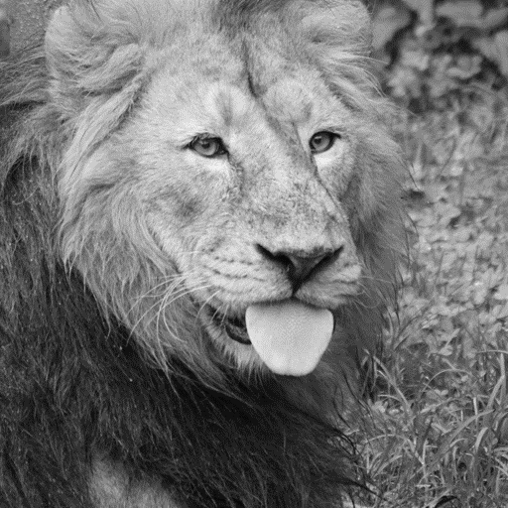
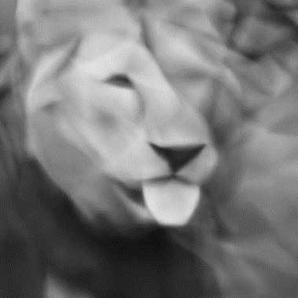
Coordinate-based neural networks
Continuous and differentiable
Notes:
There is new trend in which a neural network is trained to fit solely to a single signal.
In this direction, the input is a fixed mesh grid (e.g. linear) and the output is the pointwise evaluation of target function which could be an image, audio and so on.
After a successful training, the neural network accurately learns the target function and since they are continuous and differentiable, can replace original target function.
The problem is that in practice, neural network cannot learn high frequencies such as edges in images

Slide 7
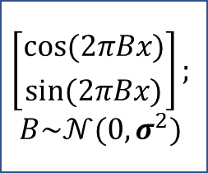
Coordinate-based neural networks
Tancik, Matthew, et al. "Fourier features let networks learn high frequency functions in low dimensional domains." arXiv preprint arXiv:2006.10739 (2020).
Fourier features
$$\left[{\text{cos}(2πBx) \atop \text{sin}(2πBx)}\right];$$
$$B\sim 𝒩(0,σ^{2})$$
Notes:
To fix that issue and enable models to learn high frequency functions too,
Fourier features has been studied to map the low-dimensional input to a higher dimension. To do so, the pipeline would be exactly the same as before and the only difference is that before passing input coordinates to a neural network, we use this mapping.
We are particularly interested in the behavior of $\sigma$ as the main hyperparameter in our work

Slide 8
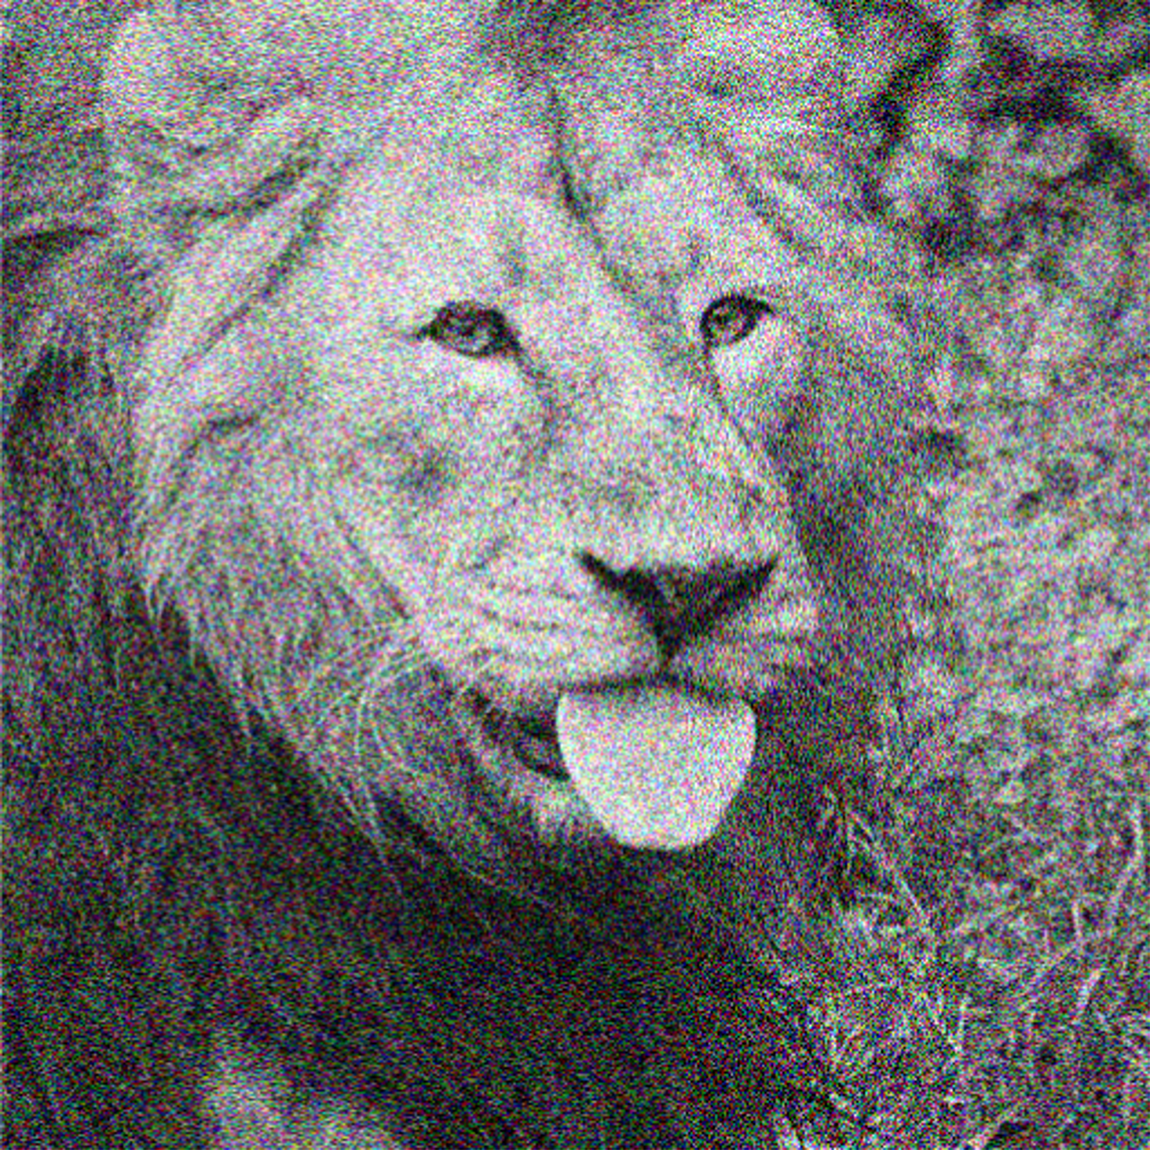
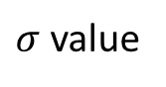
Tuning Fourier features
An example: Image representation
σ effect for “underfitting” and “overfitting”
Objective function
(e.g. L2 norm)
$σ$ value
Notes:
The discussion around using $\sigma$ is mostly limited to the idea that it has to be tuned in order to help model to converge to the solution with lowest objective function.
In that matter, using lower values leads to oversmoothed or underfitted model and higher values leads to noisy or overfitted models. So the best value is always a "middle-point" value.

Slide 9
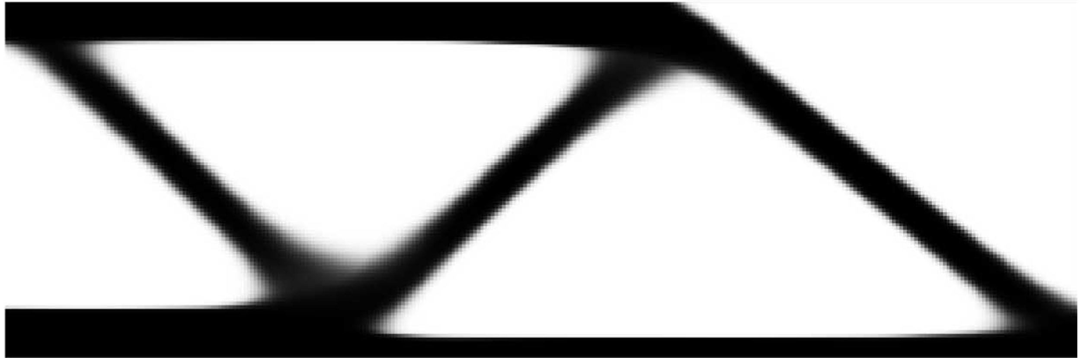
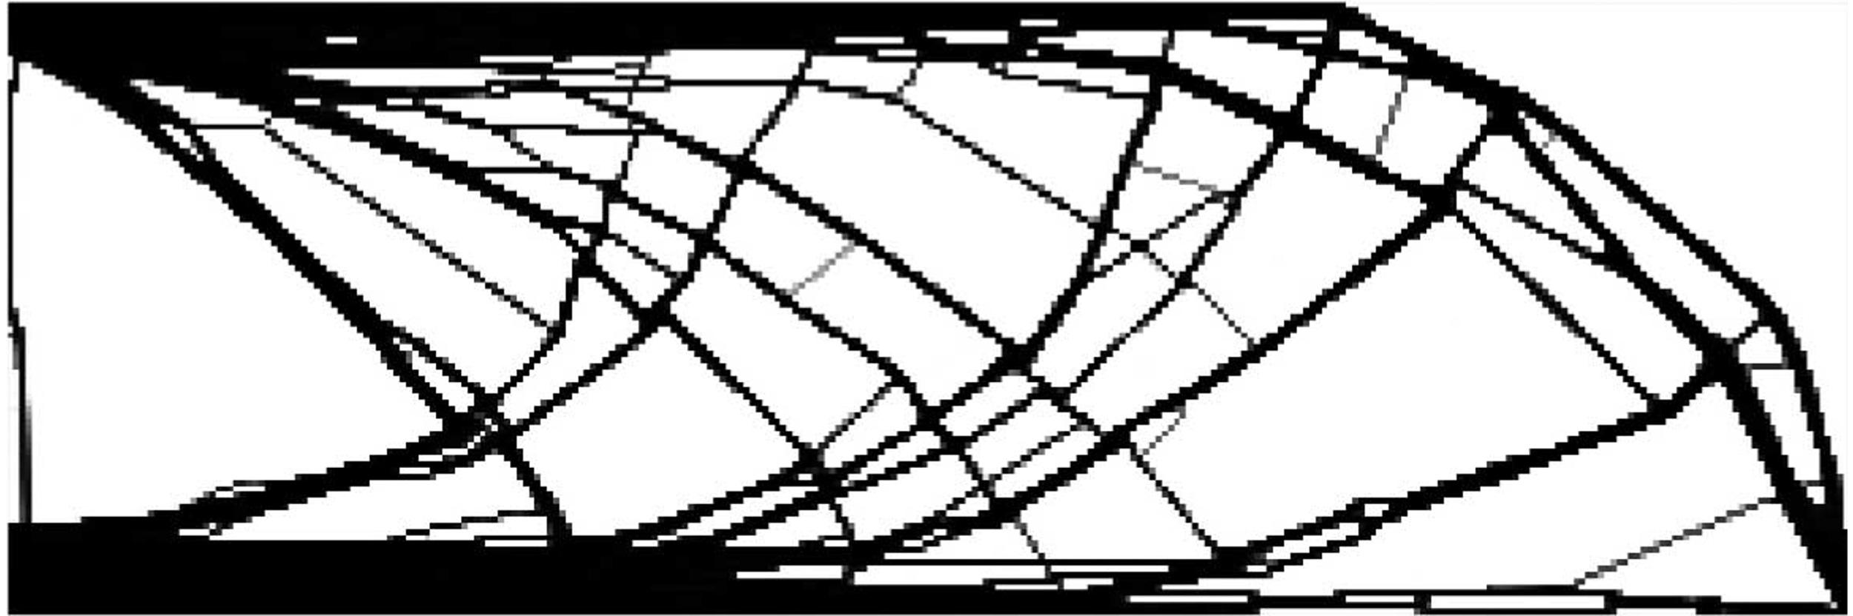
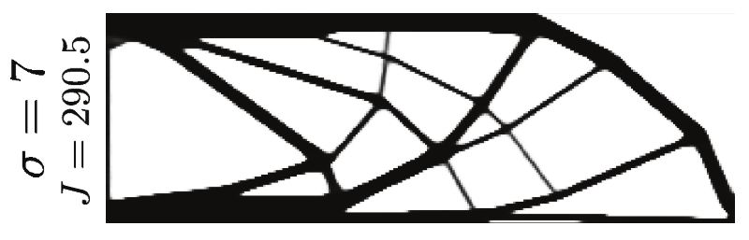
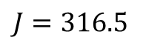
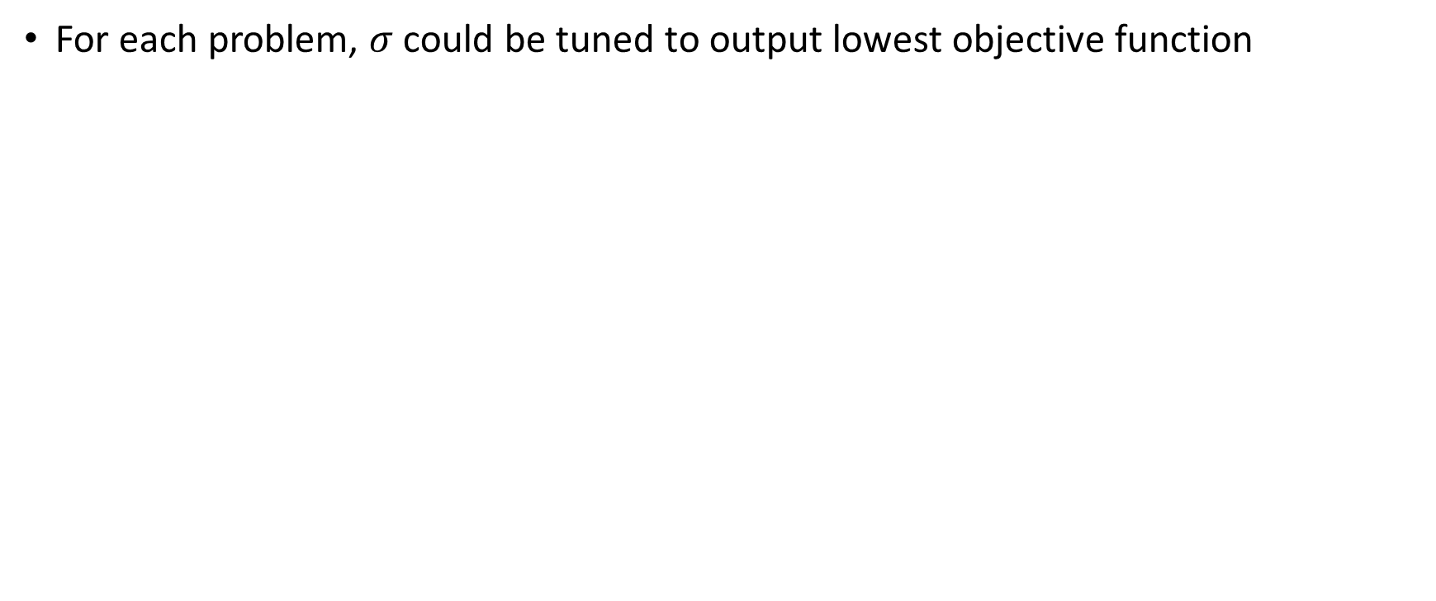
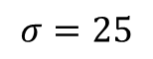
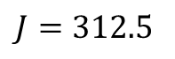
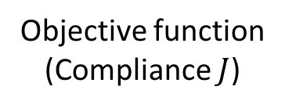
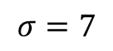
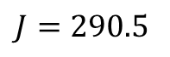
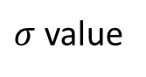
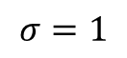
Tuning Fourier features
Design representation
For each problem, $σ$ could be tuned to output lowest objective function
$$J=316.5$$
$$J=312.5$$
$$J=290.5$$
Objective function
(Compliance $J$)
$$σ=1$$
$$σ=25$$
$$σ=7$$
$σ$ value
Notes:
We can deal with $\sigma$ similar to the way it has been introduced in prior works and only tune it to find the solution with lowest objective function, such as 2D image fitting.
Here we can see that using very low or very high $\sigma$ will increase compliance by over-smoothing or making the design noisy.
So, there is a "middle point" that obtains a low compliance.

Slide 10
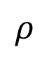
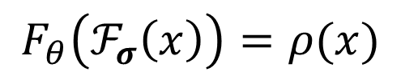
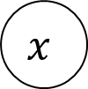
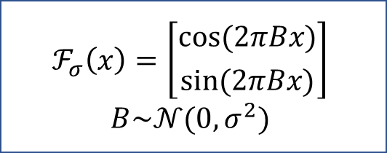
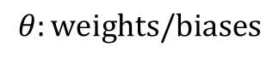
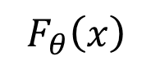
Method
Neural design parameterization
Parameterizing design variable (density) via neural network parameters
$$F_{θ}\left(x\right)$$
$$ℱ_{σ}\left(x\right)=\left[{\text{cos}(2πBx) \atop \text{sin}(2πBx)}\right]$$
$$B\sim 𝒩(0,σ^{2})$$
$$x$$
$$ρ$$
$$F_{θ}\left(ℱ_{σ}\left(x\right)\right)=ρ(x)$$
$$θ:\text{weights}\text{/}\text{biases}$$
Notes:
1. To parameterize our problem, we use the same pipeline as before with Fourier features and the goal is to train the model to learn the mapping from input mesh grid [MORE EXPRESS] to the design variable which is density field in case of TO.

Slide 11
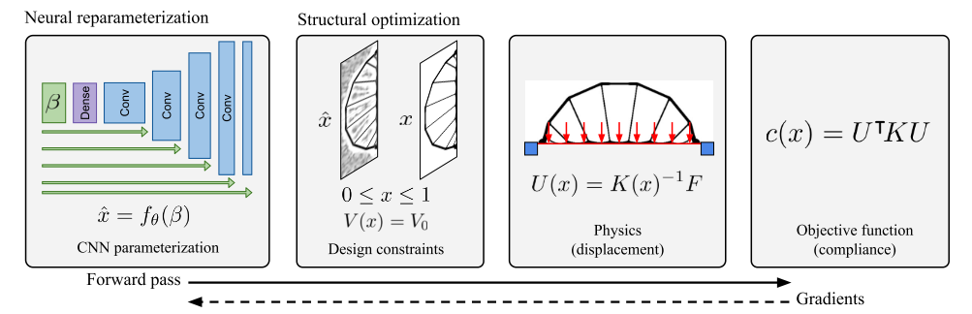
Related works
CNN
A convolutional neural network without any control over frequency prior
Hoyer, S., Sohl-Dickstein, J., & Greydanus, S. (2019). Neural reparameterization improves structural optimization. arXiv preprint arXiv:1909.04240.
Notes:
Different authors have already adopted neural design parameterization in different ways
A convolutional neural network instead of coordinate-based one without Fourier features

Slide 12
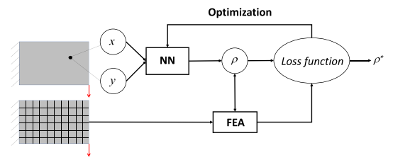
Related works
TOuNN
A coordinate-based neural network but does not use Fourier features
Chandrasekhar, A., & Suresh, K. (2021). TOuNN: Topology optimization using neural networks. Structural and Multidisciplinary Optimization, 63(3), 1135-1149.
Notes:
1. They replace CNN with Coordinate-based NN but without using Fourier mapping

Slide 13
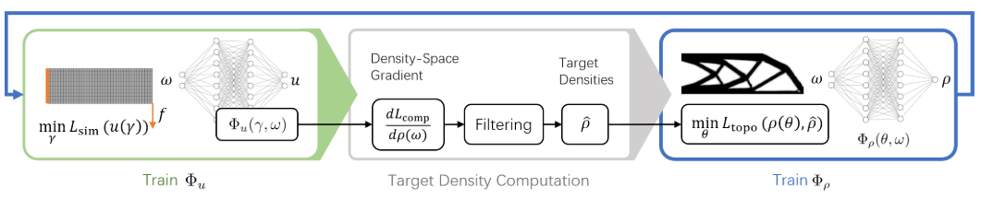
Related works
NTopo
A fully mesh-less method using coordinate-based neural networks
Treats frequency priors as a fixed hyperparameter
Zehnder, J., Li, Y., Coros, S., & Thomaszewski, B. (2021). NTopo: Mesh-free Topology Optimization using Implicit Neural Representations. arXiv preprint arXiv:2102.10782.
Notes:
1. Maybe closest to our work, authors use an entirely coordinate-based mesh-less method but they treat frequency priors as a fixed hyperparameter, similar to image representation.

Slide 14
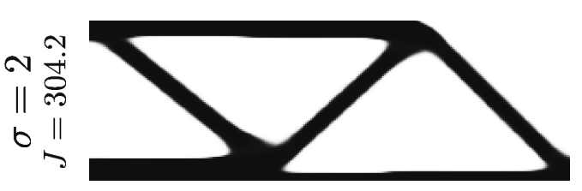
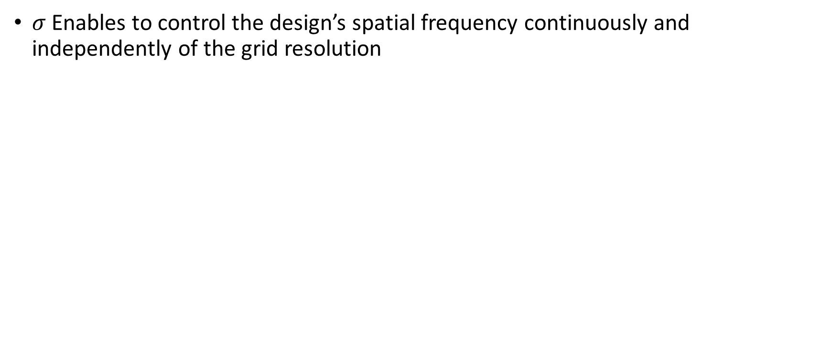
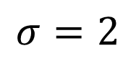
Method
Frequency priors for generative design
$σ$ Enables to control the design’s spatial frequency continuously and independently of the grid resolution
Smoothing filter can be removed: lower $σ$ filters higher frequencies
$$σ=2$$
Notes:
As our main contribution, we demonstrate that $\sigma$ has much greater power: it can be used to tune the spatial frequency of the design continuously.
In particular, by carefully setting the value of sigma we can avoid checkerboards and yet still produce highly detailed designs.
This observation enables us to remove the conventional [EXPRESS] *mesh-based* smoothing filter in all of our experiments and only rely on the fourier feature transformation to apply a controlled smoothing

Slide 15
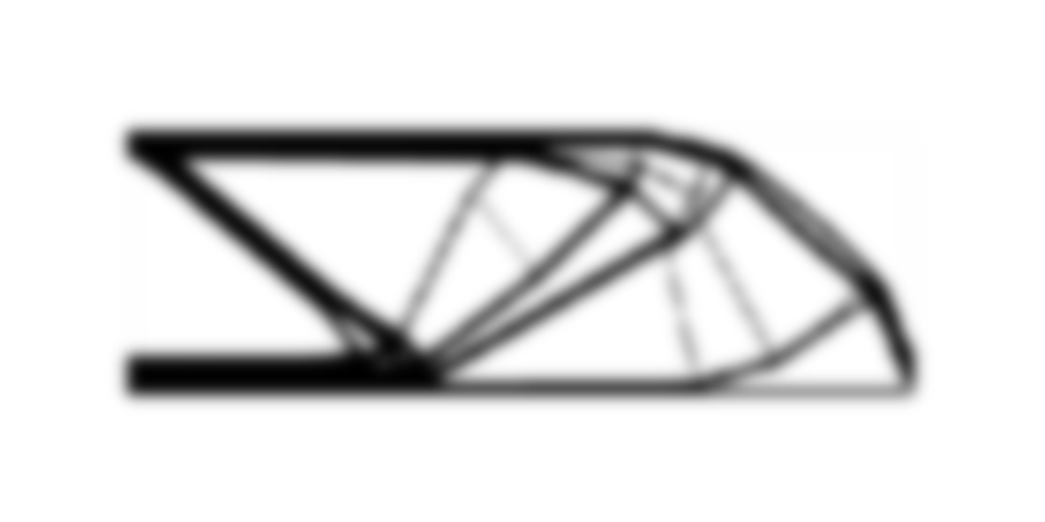
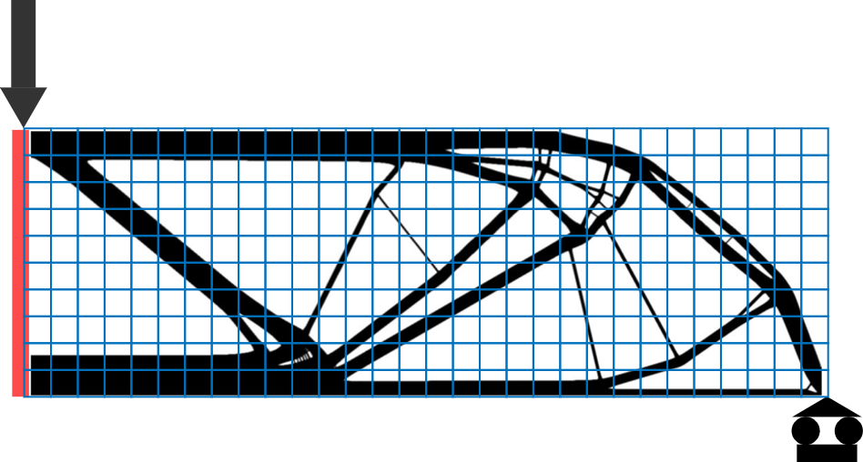
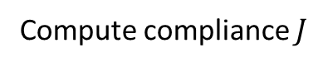
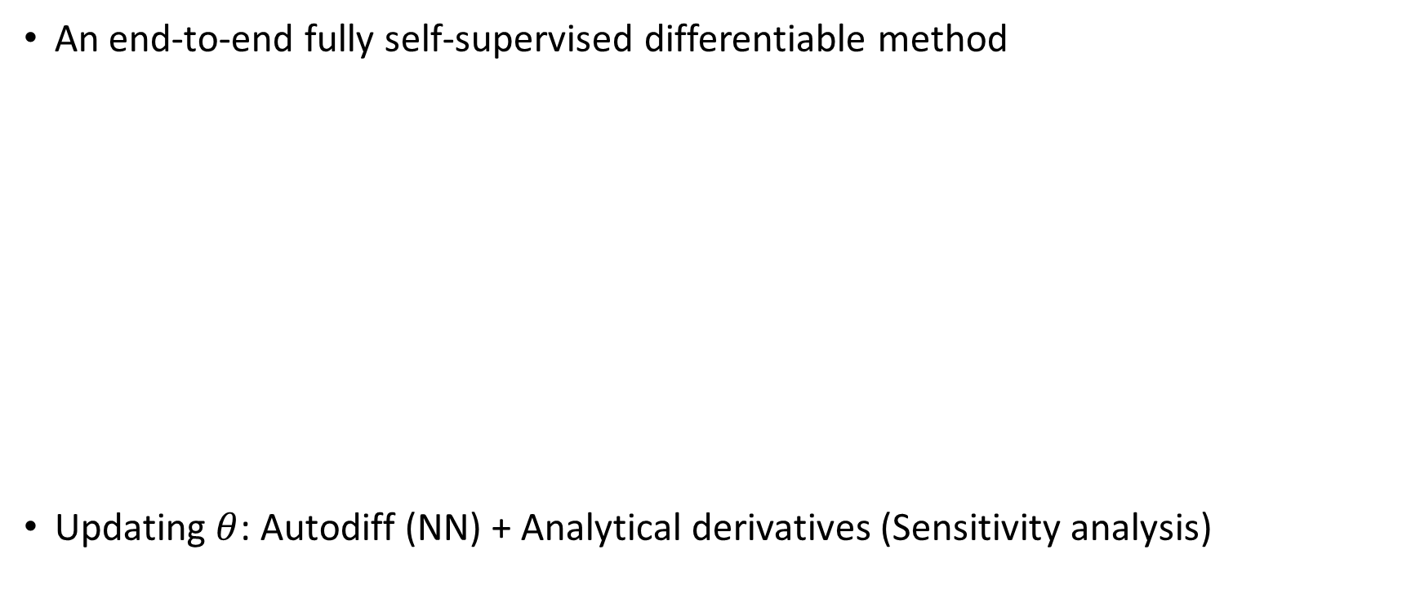




Method
Neural topology optimization
An end-to-end fully self-supervised differentiable method
Updating $θ$: Autodiff (NN) + Analytical derivatives (Sensitivity analysis)
Density field $ρ$
Compute compliance $J$
Fourier features
$$ρ$$
$$x$$
$$θ:\text{weights}\text{/}\text{biases}$$
Notes:
Using this sort of parameterization gives us the ability to have a fully differentiable, self-supervised pipeline.
It includes, first, the neural design parameterization that outputs a density field that is being evaluated using conventional voxel-based solver to compute compliance $J$ [introduce notation] as our main objective function.
To update $\theta$ , the weights and biases of the neural network, we use sensitivity analysis (the analytical derivatives of compliance w.r.t. density field) and Autodiff (the derivatives of density field w.r.t. input coordinates)

Slide 16








Frequency priors for generative design
Subvoxel filtering
$σ$ enables continuous filtering
Controlling complexity of designs via $σ$ (similar to Radius)
300x100
300x100
$σ=4$ behaves like $\text{Radius}≥1$
Radius=1
$$σ=4$$
$σ=13$ behaves like $\text{Radius}<1$
Radius=0
$$σ=13$$
Notes:
Here, we show that not only \sigma replaces the explicit mesh-based filtering, it can also represent a continuous filter in subvoxel level.
For instance, we can use small values of \sigma to obtain smooth designs similar to mesh-based filtering with radius>=1. We even can go below a voxel by using large \sigma value to obtain intricate designs.

Slide 17





Frequency priors for generative design
Mesh-independency
Definition: obtaining similar designs independent of mesh size
Similarly, fixing frequency priors by using a fixed $σ$ over resolutions
$$σ=6$$
Notes:
Mesh-dependency is one of the interesting features of TO
First, it means that we should be able to get similar structure independent of the chosen mesh size.
In our analogy, we need to fix the frequency priors that model can represent in all resolutions in play, which can be done by using a fixed $\sigma$ over each resolution.
as we can see, designs are structurally very similar. The compliance values confirm structural similarity as well.

Slide 18

Design upsampling
Why we need it
To obtain intricate designs with lower compliance, higher mesh size is needed
Upsampling is a simple and attractive way to generate designs for 3D printers
Is it possible to achieve intricate designs in coarse meshes?
HP 3D Jet Fusion 4200
Notes:
Once more, to obtain more intricate designs that have lower compliance, we need to use larger meshes, that increase computation time heavily.
Today, there is large gap between what hardware demands and what computational models can compute. To close this gap, simple upsampling of the design is desired.
The important question is: can we use our design representation to emulate higher-resolution designs while using a coarse mesh?

Slide 19



Design upsampling
$σ$ effect: controllable design
Voxel-based solver
Proposed method
Coarse mesh with large $σ$
Fine mesh
Higher $σ$ $\sim$ larger mesh size
Notes:
We evaluate the quality of designs upsampled to a fine mesh by measuring how much a traditional topology optimizer can improve the design. If the design was nearly optimal, this improvement will be small.
Tell STEPS
We can conclude by arguing that if the final design is similar to initialized one, then the obtained solution at first place by our method is representative of finer mesh.
This means that higher \sigma is analogous to higher mesh size in term of obtaining intricate design

Slide 20


Design upsampling
$σ$ effect: example
Higher $σ$ $\sim$ larger mesh size
Degradation/improvement
Longest dimension
Notes:
As an example, we use $\sigma=9$ as a large value.
We train all examples in 300x100 and then interpolate them to higher resolution as can be seen on x-axis.
Because \sigma=9 is a large value, we expect that by increasing mesh size, the improvement becomes smaller and smaller until reaches a minimum. This way we can say \sigma=9 is analogous to mesh size 750x250
In the other direction, when we do the same thing with \sigma=2 as a low value, we see that for almost all finer mesh sizes, the design is too smooth and traditional TO solver considerably improves the design

Slide 21


Design upsampling
$σ$ effect: example
Initialization density
Degradation/improvement
Converged density
Longest dimension
Notes:
To qualitatively visualize this behavior, we choose a point where a small \sigma (=2 ) has been used for a large mesh (750).
It demonstrates that if the improvement is large, then the upsampled design is not optimal.

Slide 22












Comparison with other methods
Ours
Voxel-Based
CNN
MBB Beam
300x100
$$V_{0}=0.3$$
Roof
180x180
$$V_{0}=0.4$$
Bridge
250x125
$$V_{0}=0.4$$
Notes:
Here we demonstrate our results in comparison to CNN and conventional voxel-based solver.
Note that using mesh-based filtering is mandatory in CNN and voxel-based solver.
As it can be seen, we can get more intricate designs at course meshes relatively to other methods.

Slide 23

Future work
Employing better optimizers to speed up the convergence
Bone-like structures by controlling lower bound: sparse and stable
Wu, J., Aage, N., Westermann, R., & Sigmund, O. (2018). Infill Optimization for Additive Manufacturing Approaching Bone-like Porous Structures. IEEE Transactions on Visualization and Computer Graphics, 24(2), 1127 - 1140. https://doi.org/10.1109/TVCG.2017.2655523
Notes:
NN needs way more iterations in direct optim
Controlling lower bound of Fourier features

Slide 24


Slide 25


